Slide 1
Internet of Things essentials presentation GAS AND SMOKE DETECTION SENSOR USING MQ-5 AND MQ-2 SENSOR
SRIMATHI G (210701259)
SRIMATHY R (210701260)

Slide 2
AGENDA
I. ABSTRACT
II. INTRODUCTION
III. OBJECTIVE
IV. LITERATURE SURVEY
a. KEY CHALLENGES
b. MOTIVATION
V. EXISTING SYSTEM
VI. PROPOSED SYSTEM
VII.MODULES
VIII. SYSTEM ARCHITECTURE
IX. CONCLUSION AND FUTURE ENHANCEMENTS
X. REFERENCES

Slide 3
ABSTRACT
The LPG gas leakage detector project utilizes an Arduino board interfaced with an MQ-5 gas sensor, MQ-2 Smoke sensor, buzzer, and LED to detect the presence of LPG gas and smoke which alert users of potential leaks and fire. The MQ-5 gas sensor, capable of detecting various gases, also MQ-2 sensor detects the smoke and triggers the Arduino board upon sensing LPG gas, activating both the buzzer and LED for immediate notification. This cost-effective solution finds utility in home, industrial, and commercial settings, offering a reliable means of gas detection and smoke detection to prevent accidents and safeguard lives and property.

Slide 4
INTRODUCTION
Gas and smoke detection systems are crucial for ensuring safety in various environments, from industrial settings to residential spaces. These systems monitor the presence of harmful gases and smoke in the air, providing early warnings to prevent accidents and protect human health. With the integration of Internet of Things (IoT) technology, gas and smoke detection systems have become more efficient, versatile, and accessible than ever before.

Slide 5
OBJECTIVE
To detect gases like LPG, natural gas, methane, and propane, the MQ5 sensor is commonly employed.
To serve as an early warning system, the MQ5 sensor can detect gas concentrations that could pose risks to human health or safety, promptly triggering alarms.
To ensure a safe environment, particularly in gas-prone areas or where combustible gases are utilized or stored, continuous monitoring of gas levels is essential.
To enhance overall safety measures, integrating the MQ5 gas sensor with IoT technology enables remote monitoring and data analysis capabilities

Slide 6
LITERATURE SURVEY
[1] AUTOMATIC GAS LEAKAGE MONITORING SYSTEM USING MQ-5 SENSOR 2023
Baballe, M. Ahmad, et al . The detection system comprises an Arduino microcontroller, a MQ-5 gas sensor mounted on it, an active buzzer for raising the alarm.
[2] DF] Internet of things (IOT) based gas leakage monitoring and alerting system with MQ-2 sensor
RC Pandey, M Verma, LK Sahu 2017 In this paper, commercially available gas sensors are compared with iot gas sensors possessed comparable gas sensing properties.
[3] Detection of gas leaks using the MQ-2 gas sensor on the autonomous mobile sensor
IKN Trisnawan, AN Jati, N Istiqomah 2019
Using MQ-2 gas sensor as the main detector that has a high sensitivity to types of flammable gases such as LPG.

Slide 7
LITERATURE SURVEY
[4] IoT-enabled gas sensors: Technologies, applications, and opportunities
JBA Gomes, JJPC Rodrigues, RAL Rabêlo 2019
Tells about contributions towards wireless gas sensors and IoT-enabled gas sensors .
[5]An effective iot empowered real-time gas detection system for wireless sensor networks
SA Yadav, S Sharma, L Das, S Gupta… - 2021
presented an IoT powered wireless sensor network for Gas Detection.

Slide 8
KEY CHALLENGES
Identification of gas
Requires more installation
Usage of controlled devices
Needs more maintenance

Slide 9
MOTIVATION
System is motivated by the imperative to prioritize safety, protect health, and safeguard the environment. These systems play a crucial role in detecting hazardous gas leaks early, enabling timely responses to prevent accidents and injuries. Additionally, they help mitigate environmental pollution and property damage, ensuring regulatory compliance and effective risk management. By continuously monitoring gas levels and providing real-time alerts, gas detection systems offer peace of mind to individuals and organizations, assuring them that potential gas hazards are being effectively monitored and addressed.

Slide 10
EXISTING SYSTEM
Traditional gas detection systems often suffer from limited coverage, high installation and maintenance costs, complex installation processes, and limited connectivity. These systems may struggle to detect gases effectively in larger areas or complex environments, and their high costs make them less accessible for smaller-scale applications or DIY projects. Moreover, the complex installation process and lack of user-friendly interfaces require specialized knowledge and professional assistance. Additionally, traditional systems may lack connectivity features, making it challenging to integrate them with other devices or systems for remote monitoring and data analysis.

Slide 11
PROPOSED SOLUTION
The LPG gas leakage detector project utilizing Arduino and MQ-5 gas sensor addresses these shortcomings. By utilizing an MQ-5 gas sensor capable of effectively detecting LPG gas within its range, the proposed system provides localized detection and alerting. Moreover, by utilizing affordable components such as the Arduino board, MQ-5 gas sensor, buzzer, and LED, the proposed system offers a cost-effective solution, making gas detection technology more accessible and added advantage of detecting smoke using MQ-2 Sensor . Simplifying the installation process with a user-friendly interface for programming and operation, the proposed system enables even non-experts to set up and use the system effectively. Furthermore, by incorporating IoT technology, the proposed system enables remote monitoring and data analysis capabilities, overcoming the limited connectivity of traditional systems and enhancing overall safety and convenience.

Slide 12
MODULES
MQ-5 sensor
MQ-2 sensor
Arduino Uno
Buzzer
Led light
Bread board
Battery
Software - Arduino ide

Slide 13
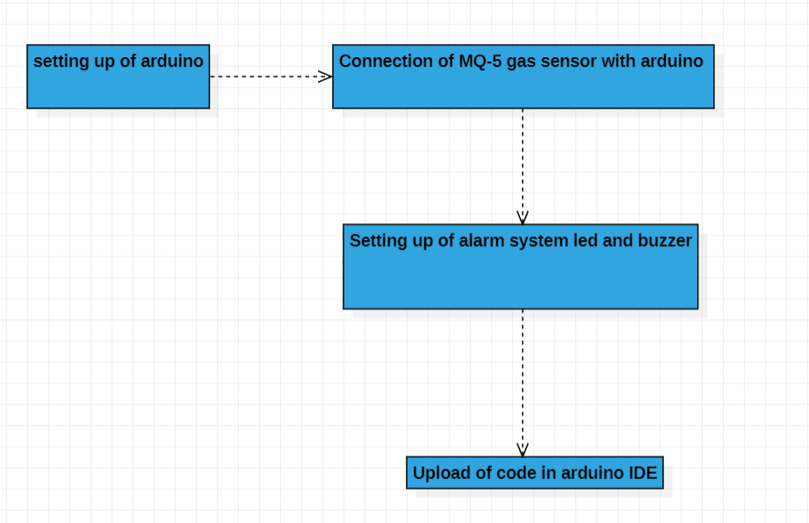
SYSTEM ARCHITECTURE

Slide 14
CONCLUSION
The system provide the control action during gas leakage and it activate the alarm with in a short time it is an economical system can be installed in apartments what else and wherever it is needed the cost of the proposed system is lesser than the commercially available detectors in the market it can help us to prevent from accidents in all directions. There are some products available which is which are similar to this classic case detector but those are not caused efficient and does not have any safety mechanism if this product becomes commercial it will overcome all demerits of other similar products.

Slide 15
FUTURE ENHANCEMENTS
Future enhancements in gas and smoke detection systems using IoT will feature advancements in sensor technology, AI integration for data analysis, and edge computing for real-time responses. Autonomous sensor networks with self-configuring capabilities will ensure continuous monitoring coverage, while integration with smart infrastructure and predictive maintenance will optimize system performance. Additionally, blockchain technology will enhance data security, and augmented reality interfaces will improve situational awareness for better decision-making during gas incidents.

Slide 16
REFERENCES
[1] Baballe, M.A., Magashi, U.Y., Garko, B.I., Umar, A.A., Magaji, Y.R. and Surajo, M., 2021. Automatic gas leakage monitoring system using MQ-5 sensor. Review of Computer Engineering Research, 8(2), [31 Kickert. W.J.L and Mamdani.E.H, "Analysis of fuzzy logic controller", Fuzzy Sets and Systems, vol 1, issue1, Jan 1978, pp. 29-44.
[2] I. K. N. Trisnawan, A. N. Jati, N. Istiqomah and I. Wasisto, "Detection of Gas Leaks Using The MQ-2 Gas Sensor on the Autonomous Mobile Sensor," 2019 International Conference on Computer, Control, Informatics and its Applications (IC3INA), Tangerang, Indonesia, 2019, pp. 177-180, doi: 10.1109/IC3INA48034.2019.8949597.
[3] Al-Fuqaha, A.; Guizani, M.; Mohammadi, M.; Aledhari, M.; Ayyash, M. Internet of Things: A Survey on Enabling Technologies, Protocols, and Applications. IEEE Commun. Surv. Tutor. 2015, 17, 2347–2376.
[4] Gershenfeld, N., Krikorian, R. and Cohen, D. (2004) The Internet of Things. Scientific American,
[5] Liu, X.; Cheng, S.; Liu, H.; Hu, S.; Zhang, D.; Ning, H. A survey on gas sensing technology. Sensors 2012, 12, 9635–9665.
[6] S. A. Yadav, S. Sharma, L. Das, S. Gupta and S. Vashisht, "An Effective IoT Empowered Real-time Gas Detection System for Wireless Sensor Networks," 2021 International Conference on Innovative Practices in Technology and Management (ICIPTM), Noida, India, 2021, pp. 44-49, doi: 10.1109/ICIPTM52218.2021.9388365.

